Slide 1
INVENTORY MANAGEMENT SYSTEM -VAISHNAVI S
MY INVENTORY MODULE MANAGES INVENTORY OF FRAMES,CONTACT LENSES AND OTHER OPTICAL MISCELLANEOUS.
INVENTORY MANAGEMENT
SALES BILLING
PURSCHASING
DISCOUNTS
CUSTOMER &SUPPLIER ACCOUNT
WITH ALL HISTORY AND DOCTORS PRESCRIPTION

Slide 2

OPTICARE - IMS
BETTER STOCK MANAGER

Slide 3
OPTICARE-IMS
HOME | ABOUT | CONTACT US
 | LOGIN
USERID
PASSWORD
LOGIN | RESET | BACK
NEW REGISTRATION | FORGOT PASSWORD

Slide 4
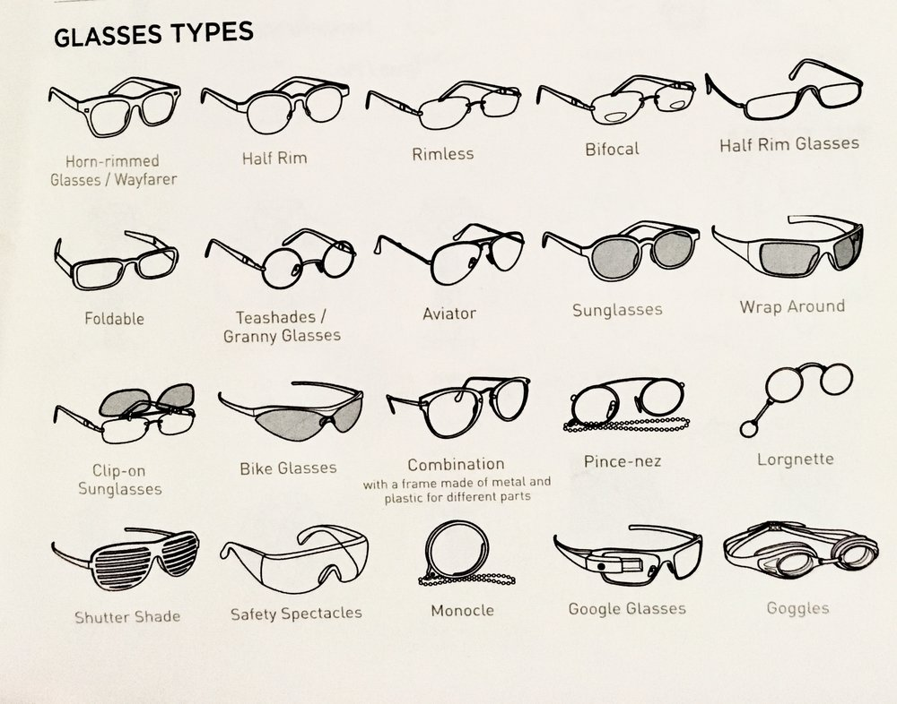
ABOUT
CONTENT....

Slide 5
CONTACT US
PHONENO.
EMAIL
OTHER SOCIAL MEDIA CONTACTS.....

Slide 6
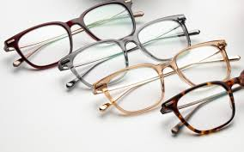
OPTICARE-IMS
DASHBOARD
PRODUCT
SALES
PURSCHASE
STOCK –IN &OUT
BILLING
EXIT
QUOTATION | CUSTOMER PROFILE
DOCTOR PROFILE | WARNINGS

Slide 7
CUSTOMER PROFILE
CUSTOMER ID: | PRESCRIPTION ID:
EYE DETAILS
CONTACT
AGE
ADDRESS
EYE | SPH | CYL | AXIS | VD | NEAR ADD | VN
RIGHT
LEFT
MODELNO. |  | BRAND
FRAMETYPE |  | LENS PRICE
LENS SIDE |  | FRAME PRICE
PAID AMOUNT |  | TOTAL AMOUNT
ADD | DELETE | UPDATE | EXIT

Slide 8
DOCTOR PROFILE
DOCTOR NAME:
PRESCRIPTION ID:
CONTACT:
SAVE | DELETE

Slide 9
OPTICARE-IMS
DASHBOARD
PRODUCT
SALES
PURCHASE
STOCK
REPORT
EXIT
PRODUCT
CATEGORY
EYEGLASSES | COMPUTER GLASSES | CONTACT LENSES
SUNGLASSES | KIDS GLASSES | READING GLASSES
POWER GLASSES | LENS CLEANER | OTHER GLASSES

Slide 10

eyeglasses
SEARCH GO | FILTERBY -----
IMAGE
MODELNO.
BRAND
FRAME TYPE
SIZE
PRICE
PRICE+GST=TOTAL
UNIT | + | --
ADD PRODUCT | DELETE
UPDATE | EXIT

Slide 11
STOCK
MODELNO. | BRAND | PRICE TYPE | SIZE | SALES PRICE | PURCHASE PRICE | UNIT | TOTAL STOCK AVAILABLE

Slide 12
INVOICE
BILL RECEIPT | ADD | CANCEL
BILL TO: | INVOICE NO: DATE: DUE DATE:
# | BRAND | MODELNO. | UNIT | RATE | DISCOUNT | GST | TOTAL
1.
2.
 | TOTAL
AMOUNT(INWORDS)
DECLARATION: WE DECLARE THAT THIS INVOICE SHOWS THE ACTUAL PRICE OF GOODS DESCTIBED AND THAT ALL PARTICULARS ARE TRUE AND CORRECT
AUTHORISED SIGN/NO.

Slide 13
REPORT
CUSTOMER REPORT
SALES REPORT
PURCHASE REPORT
PRODUCT REPORT
EXAMPLE
CUSTOMER REPORT
SORT BY DATE | SORT BY MONTH
PRINT | EXIT

